Slide 1
PROJECT REPORT
1.Introduction to Bright Ideas Consult:
At Bright Ideas Consult, we illuminate the path to success through innovative thinking, strategic solutions, and unwavering commitment to our clients. Our mission is to spark transformation by providing cutting-edge consultancy services tailored to your unique needs.

Slide 2
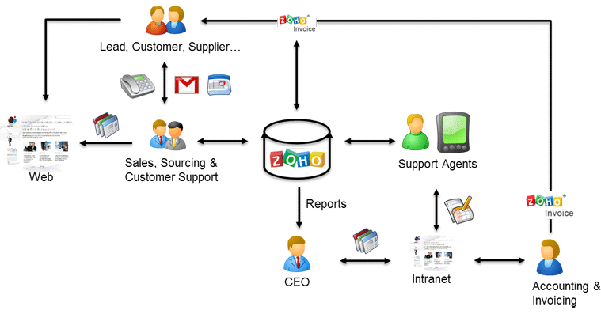
Preparation and Maintanence of ZOHO Books for Bright Ideas Consulting
Bright Ideas Consulting, a consulting firm, relies on Zoho Books to track their billable hours, expenses,
and client invoices. The software helps them accurately calculate project costs, monitor profitability,
and generate reports for better financial management.
Bright Ideas Consulting is a Private Limited company also registered under GST in Tamil Nadu. Bright
Ideas Consulting offers various expert consulting services in India and outside India.

Slide 3
Problem Definition:
At Bright Ideas Consulting, we believe that identifying and clearly defining the problem is the critical first step in any successful consulting engagement.
Design Thinking Process:
once the problem is well-defined, Bright Ideas Consulting employs design thinking principles to create innovative solutions that address the challenges effectively. Our design thinking process typically consists of the following stages.

Slide 4
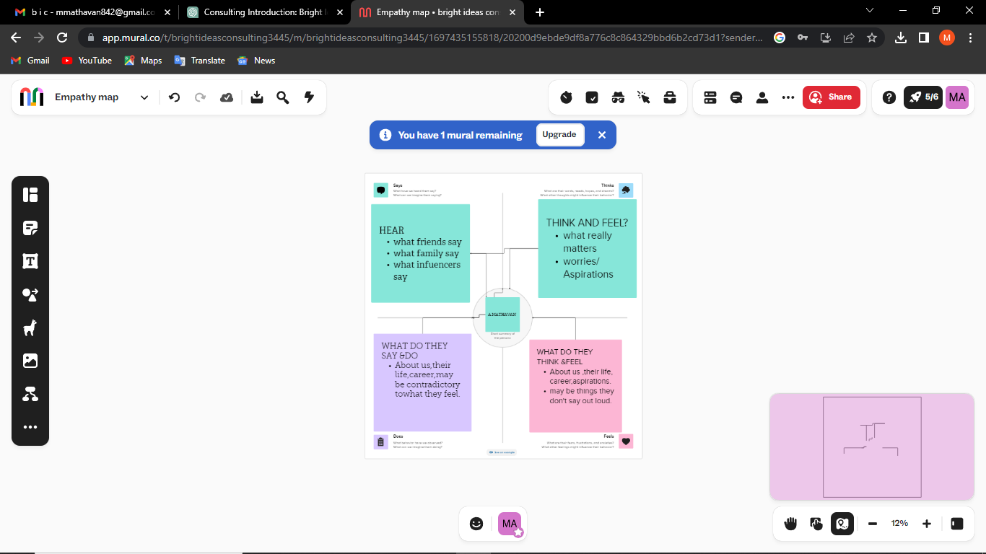
Empathy Map

Slide 5
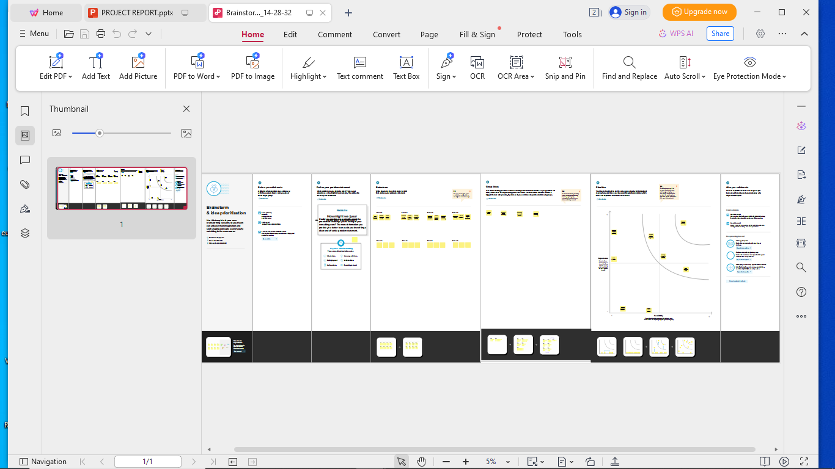
RESULT Output: 1.Company Name Creation:

Slide 6
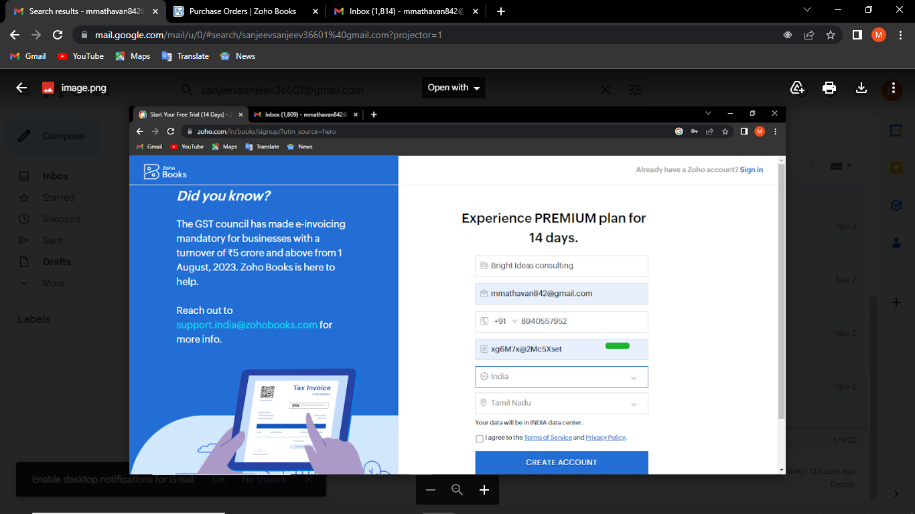
We have to create our Company Name And other Details From Below Zohobooks
2. Item Creation: We have to create items, Such as
➢ Item names
➢ Units
➢ HSN/SAC
➢ Selling info/Purchase info
➢ Tax Rate

Slide 7
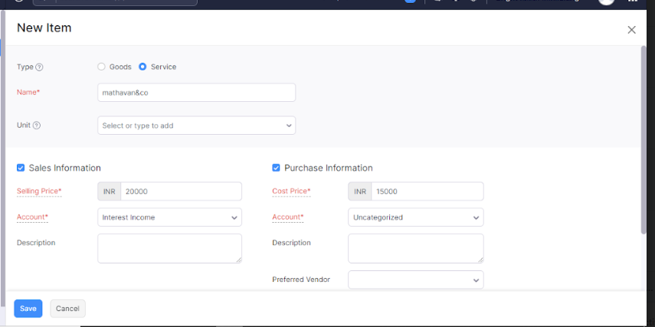
Item Creation

Slide 8
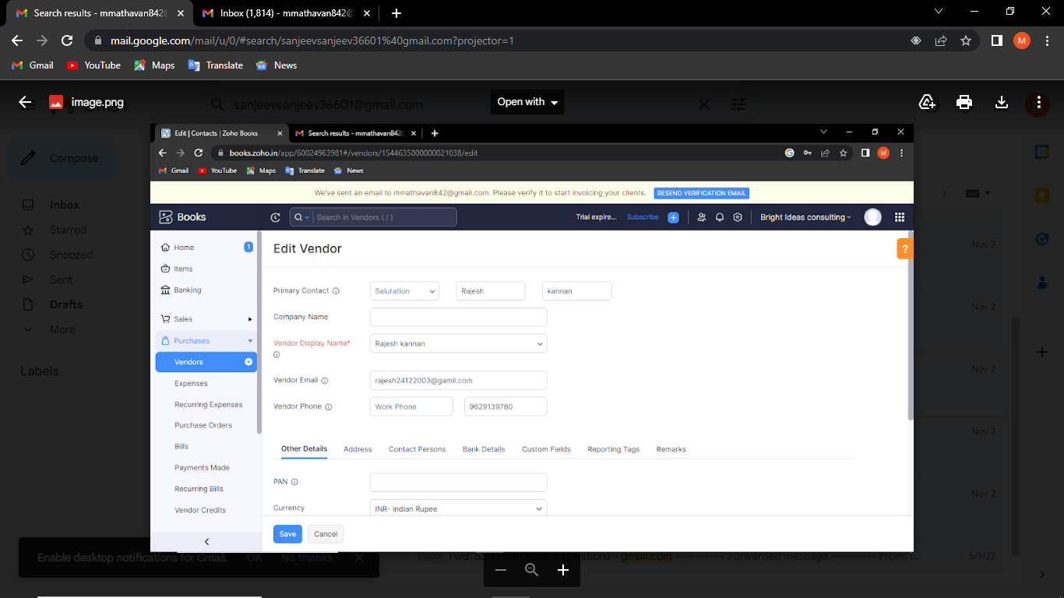
3. Vendor Creation: Now create Vendor in books from navigator panel Create New Vendor For example ➢property sales person

Slide 9
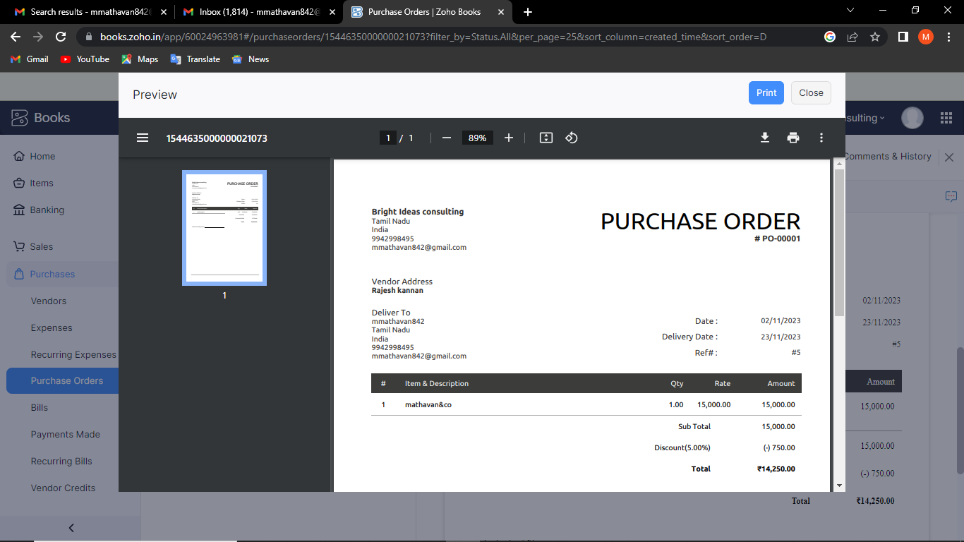
4. Purchase Order: We are creating new purchase order such as below

Slide 10
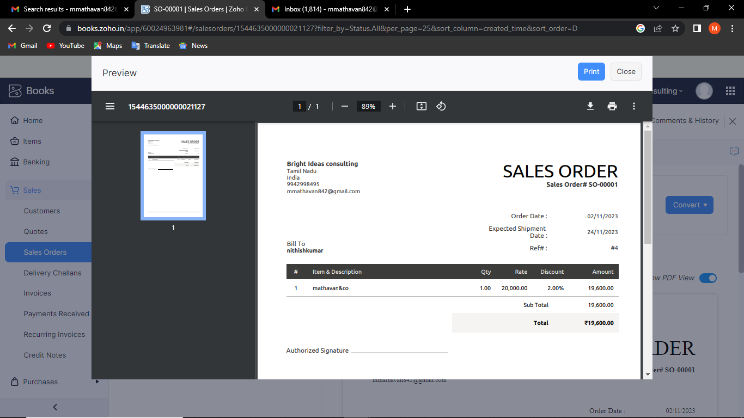
5. Sales Order:

Slide 11
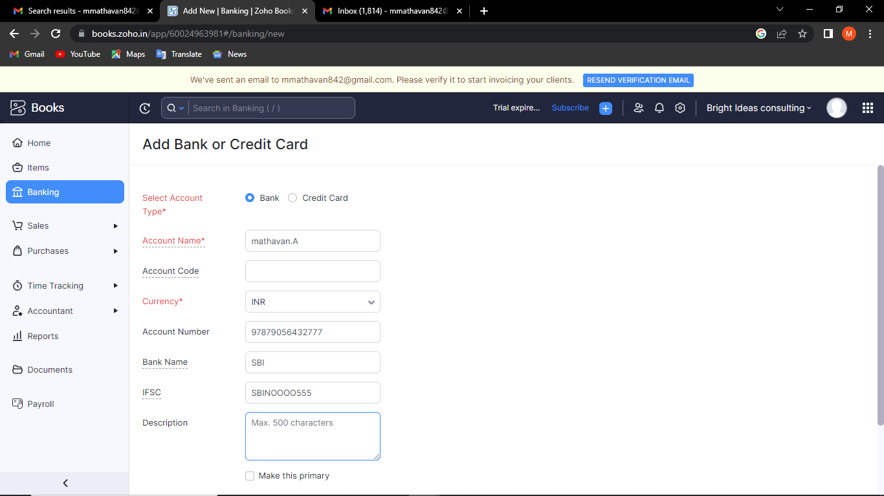
6.Payment to Bank Details:

Slide 12
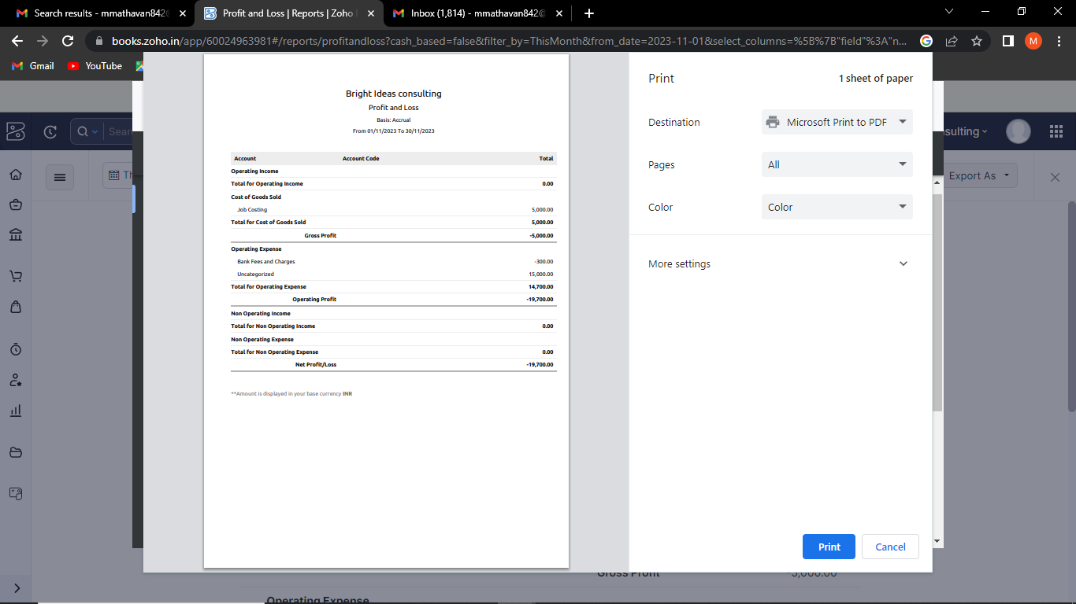
7. Profit and loss Account\ Balance Sheet\GST Report :

Slide 13
4. ADVANTAGE & DISADANTAGE: ADVANTAGE: Easy for Managing day to day activities. DISADVANTAGE: Missing New Version. 5. APPLICATION: This application used to maintain the company details and ledger accounts, profit and loss Account and Balance sheet of the Bright Ideas Consulting.
6. CONCLUSION:
I'm not sure what specific information or context you are looking for regarding "Bright Ideas Consulting." To provide a conclusion or insight, I would need more information about the company, its goals, services, or any specific topic related to it.
7. FUTURE SCOPE:
The future scope of Bright Ideas Consulting, or any consulting firm, depends on various factors such as market trends, industry developments, and the company's ability to adapt and innovate. Here are some potential future directions and opportunities for Bright Ideas Consulting:
8. APPENDIX:
➢ Approved developmen
➢ Future Assessmen
➢ Plan of development
➢ Development Purpose
➢ Interpretation

